Slide 1

Mini Project-I (K24MCA18P) Odd Semester Session 2024-25
FitSphere
Yashvi Chaudhary – 2024MCA2207
Tushar Kumar – 2024MCA0218
Tanisha Jain – 2024MCA
Project Supervisor:
Divya Singhal
Assistant Professor

Slide 2
Content
Introduction (1 slide)
Literature Review (2 slides)
Objective of the Project (1 slide)
Technology
Hardware Requirements (Development Environment, Server requirement (if required), Client requirement (if required).
Software Requirements (Language and Platforms like Frameworks, VS code, Android Studio and Jupyter notebook etc. )
Modules (2-3 slides)
Workflow (1 slide)
Reports (For Example: Project : Student Monitoring System, so reports like: Student Marks, Subjects, companies visit, and student appears in placement etc.)
References (1 slide)
Notes:
Font Styles: Times New Roman + Font Size: 25

Slide 3
Introduction
FitSphere is a health app designed to assist users in achieving their weight loss goals by offering personalized diet charts and exercise plans based on individual preferences and goals.
It is a comprehensive online platform dedicated to providing reliable health information.
The goal is to empower users with knowledge to make informed health decisions.
Features: health articles, symptom checkers, expert advice, fitness guides, mental health resources, etc.
Notes:
Font Styles: Times New Roman + Font Size: 25

Slide 4
Literature Review
Existing Solutions in Health & Fitness Apps
Several health and fitness apps, such as MyFitnessPal, Noom, and Fitbit, provide users with diet and exercise tracking tools. However, these apps often lack personalized and adaptive plans tailored to individual weight loss goals. Research highlights that apps with customized diet and exercise plans tend to achieve better user engagement and long-term success.
FitSphere addresses this gap by offering tailored diet charts and dynamic workout plans based on real-time user progress. Unlike static plans in other apps, FitSphere adjusts its recommendations as users move closer to their weight loss goals, ensuring a more personalized and relevant experience.
Notes:
Font Styles: Times New Roman + Font Size: 25

Slide 5
Literature Review (Contd.)
Current apps like Noom offer psychological-based weight loss support, while Fitbit emphasizes fitness tracking through wearable devices. However, these platforms either focus solely on one aspect (diet or exercise) or lack real-time adaptability. Additionally, studies show that personalized feedback is key to sustained motivation (Johnson & Lee, 2019).
FitSphere integrates both diet and exercise tracking while continuously adapting plans, providing users with holistic support throughout their journey. By offering detailed progress reports and personalized adjustments, FitSphere aims to enhance user engagement and weight loss success.
Notes:
Font Styles: Times New Roman + Font Size: 25

Slide 6
Objective of the Project
Fitness Health Website Objective
1. Promote a Healthy Lifestyle
Encourage users to adopt sustainable fitness and nutrition habits.
Provide educational resources on physical and mental wellness.
Inspire regular exercise, proper nutrition, and self-care routines.
2. Offer Tailored Fitness Programs
Provide personalized workout plans for various fitness levels (beginner, intermediate, advanced).
Include a variety of programs (weight loss, muscle building, cardio, flexibility, etc.).
Integrate tools for tracking progress and setting fitness goals.
Notes:
Font Styles: Times New Roman + Font Size: 25

Slide 7
Technology (Hardware Requirements)
1. Web Server Hardware
Processor (CPU): Multi-core processor (Quad-Core or higher) to handle multiple user requests efficiently.
RAM (Memory): Minimum 8GB, but recommended 16GB or higher for better performance under heavy traffic.
2. Content Delivery Network (CDN) Integration
Edge Servers: Geographically distributed servers to ensure quick access to static content (images, videos)
no matter where users are located.
3. Database Server Requirements
Processor (CPU): Multi-core processor to handle large volumes of user data (activity logs, health metrics, workout tracking).
RAM: At least 16GB to ensure smooth database transactions and user data retrieval.
Notes:
Font Styles: Times New Roman + Font Size: 25

Slide 8
Technology (Software Requirements)
Software Requirements
Frontend: HTML, CSS, BOOTSTARP, JAVASCRIPT.
Backend: PHP, MySQL for database management.
Frameworks: React Native CLI, Laravel (for backend API development).
IDE: VS Code for coding, Android Studio for Android testing, Xcode for iOS testing.
Additional Tools: Jupyter Notebook for data analysis and progress tracking algorithms.
Notes:
Font Styles: Times New Roman + Font Size: 25

Slide 9
Modules
User Interface (UI) and Design Module
Responsive Design:
Ensures the website adapts seamlessly to various screen sizes, from mobile phones and tablets to desktops.
Uses a CSS framework like Bootstrap or Tailwind CSS for grid systems and responsiveness.
Clean and Intuitive Layout:
Prioritizes ease of navigation, ensuring users can quickly access key features like workout plans, progress tracking, or nutrition guides.
Common sections include navigation bars, side menus, and footers that link to essential parts of the site.
Color Scheme and Typography:
Chooses a color palette and fonts that reflect the fitness theme, typically using vibrant, energetic colors like blue, green, and orange.
Makes sure text is legible and appropriately sized for readability on all devices.
Notes:
Font Styles: Times New Roman + Font Size: 25

Slide 10
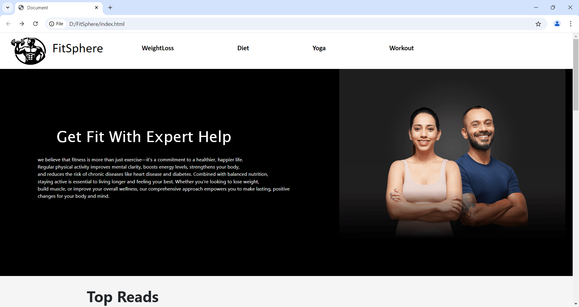
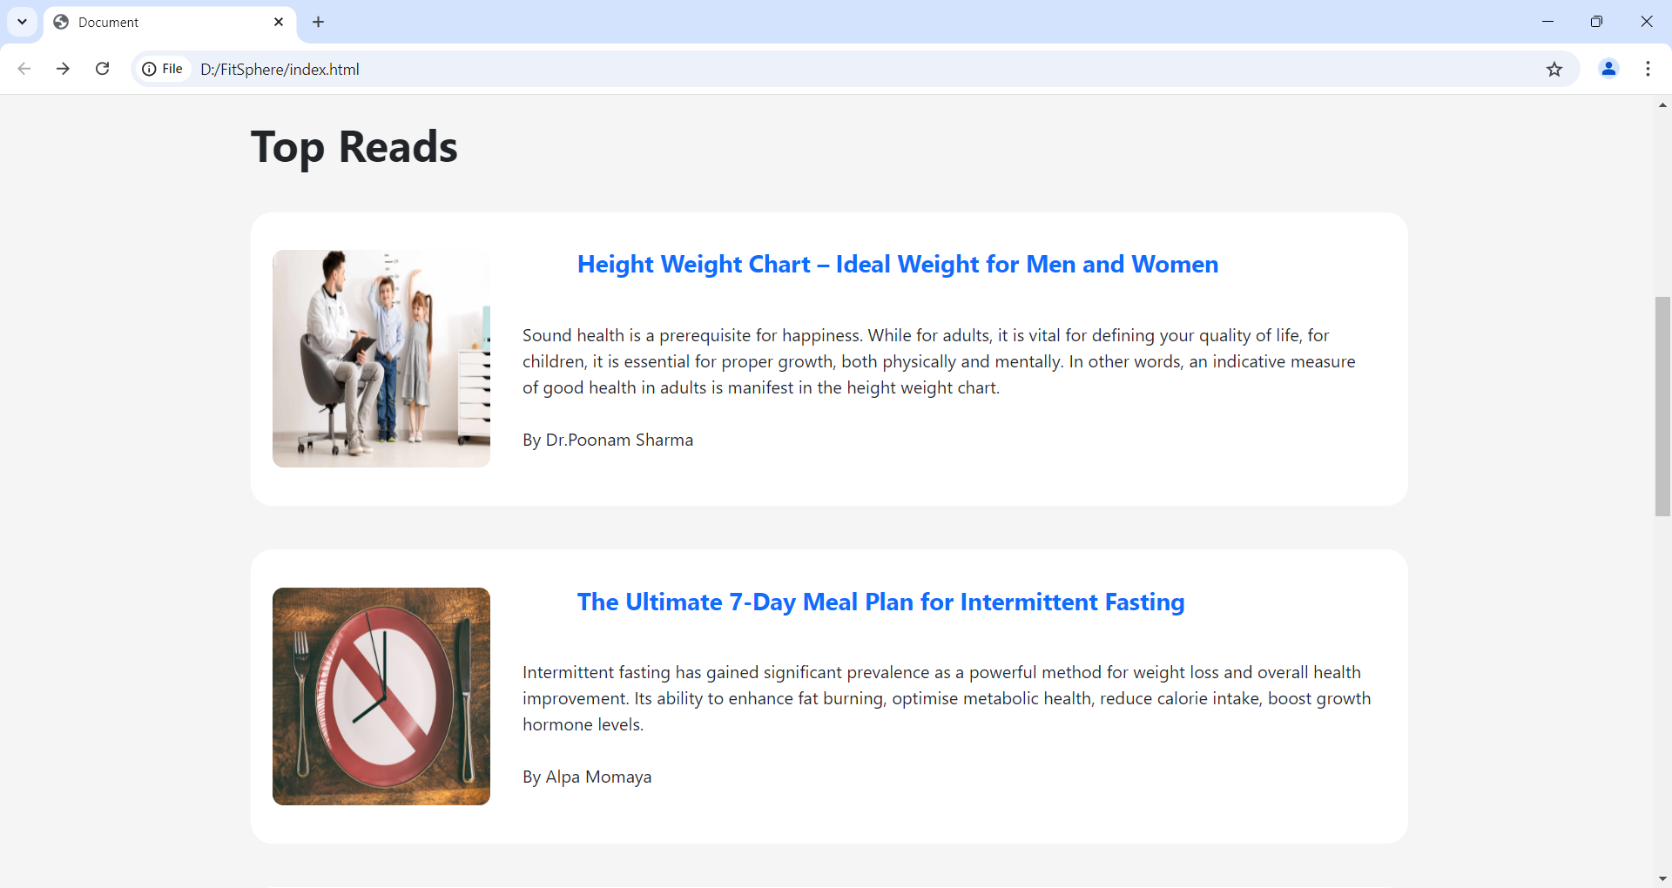
Modules
Notes:
Font Styles: Times New Roman + Font Size: 25

Slide 11
Modules
Nutrition and Meal Plan Module
Meal Plan Display:
Showcases meal plans tailored to the user’s fitness goals (weight loss, muscle gain) and dietary preferences (vegetarian, keto, etc.).
Users can navigate through meals (breakfast, lunch, dinner, snacks) with nutritional information like calorie counts and macronutrient breakdowns.
Recipe Search and Filter:
A search function using JavaScript and filters (e.g., meal type, calorie count, prep time) to help users find specific recipes easily.
Interactive Calorie and Macro Tracker:
Users can input meals they’ve eaten, and the system dynamically updates calorie and macro counts on the frontend using APIs for real-time tracking.
Notes:
Font Styles: Times New Roman + Font Size: 25

Slide 12
Modules (Contd.)
Authentication and Security Module
Login/Registration Forms:
Includes responsive forms for user authentication, with validation using JavaScript to check for required fields, strong passwords, and other form requirements.
Option to log in using social accounts (e.g., Google, Facebook) or email.
Password Recovery and 2FA:
Provides a secure password recovery system and an optional two-factor authentication (2FA) setup using JavaScript and backend integration.
Workout and Meal Reminders:Sends popup notifications or banners reminding users of their scheduled workouts or meal plans. This can be done using browser notifications or integrated push notification services.
Notes:
Font Styles: Times New Roman + Font Size: 25

Slide 13
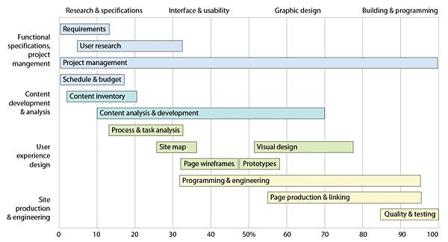
Workflow/Gantt Chart
FitSphere Workflow
Step 1: User registers and inputs weight loss goals.
Step 2: App generates a customized diet and exercise plan.
Step 3: User tracks daily progress via the dashboard
(weight, calories, exercises).
Step 4: Reports and feedback based on progress,
with adjustments to the plan if needed.
Responsive Design Testing
Verify the website works properly on mobile and desktop devices.
Notes:
Font Styles: Times New Roman + Font Size: 25

Slide 14
Reports
Progress Reports
1.Introduction
Objective:
The primary goal of this health and fitness website is to provide users with a platform to track their fitness goals, follow workout plans, monitor nutrition, and stay motivated.
Target Audience:
Fitness enthusiasts, beginners looking for guidance, and individuals seeking personalized fitness programs.
2.Website Features Overview
User Registration & Profile Management:
Secure sign-up/login
Profile customization and goal setting
Workout Plans & Exercise Library:
Predefined and customizable workout plans
Searchable exercise database with video tutorials
Notes:
Font Styles: Times New Roman + Font Size: 25

Slide 15
Reports
Progress Reports
3.Technology Stack
Frontend Technologies:
HTML5, CSS3, JavaScript
JavaScript frameworks: React.js or Vue.js
4: Development Phases
Planning and Requirements Gathering:
Market research, feature specifications, wireframing.
UI/UX Design:
Mockups, responsive design, and user flow.
Frontend Development:
Creating navigation, user dashboard, and workout/nutrition modules.
Testing and Quality Assurance:
Cross-browser, responsive, and security testing.
Deployment:
Final review, hosting setup, and live launch.
Notes:
Font Styles: Times New Roman + Font Size: 25

Slide 16
References
1. Books
“The New Rules of Lifting” by Lou Schuler and Alwyn Cosgrove A comprehensive guide on weight training and fitness strategies for various goals.
“How Not to Die” by Michael Greger Focuses on nutrition and its role in health and disease prevention.
2. Academic Journals
Journal of Physical Activity and Health Research on physical activity's role in health promotion.
3. Online Resources
Centers for Disease Control and Prevention (CDC) Website: cdc.gov Information on physical activity guidelines and health benefits.
4. Fitness and Health Websites
MyFitnessPal Website: myfitnesspal.com A popular platform for tracking nutrition and exercise.
5. Government and Health Organizations.
National Institutes of Health (NIH) Website: nih.gov Provides research and resources on health and wellness topics.
6. Case Studies
Case Study: Successful Health and Fitness Websites Analysis of popular fitness websites and their business models.
Notes:
Font Styles: Times New Roman + Font Size: 25

